Slide 1
Unsupervised Chunking for IL (Hindi)
NLP Project
Tanishq Goel
Chayan Kochar

Slide 2
TABLE OF CONTENTS
01
02
03
Abstract
Introduction
Implementation
04
05
06
Observations
Error Analysis
Conclusion
Topic of the section
Concept Learning
How we implemented our model?
Inferences of the Model
Comparison between different models
The end

Slide 3
Abstract
The aim of this project is to create a phrase based chunking algorithm for Indian Languages using unsupervised approach. We utilized clustering techniques to implement this model. Two Algos used for clustering are K-means and Hierarchical which are introduced in the following slides.

Slide 4
Why follow Unsupervised Approach?

Slide 5
PROJECT CHECKPOINTS
GOAL 1
GOAL 2
GOAL 3
GOAL 4
Implementation of the two mentioned clustering algo independent of NLP.
Incorporated NER to take care of a particular case.
Chunking through clustering techniques
Main aspect of the project is to analyse the errors by comparing different models

Slide 6
TIMELINE
2-3rd Week of March
4th Week of March
1-2nd Week of April
3rd Week of April
4th Week of April
Exploration
Implementation of Clustering Techniques
Incorporating NLP
NER implementation to handle some specific case
Modifications in the model and Error Analysis

Slide 7
Clustering Techniques
K-Means Clustering
Hierarchical Clustering

Slide 8
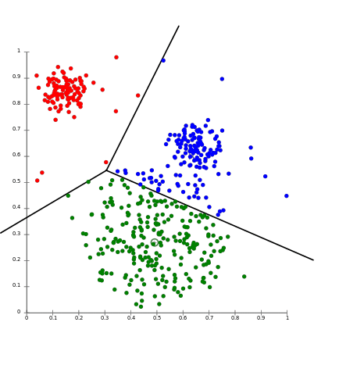
K-Means
The ‘means’ in the K-means refers to averaging of the data; that is, finding the centroid.

Slide 9
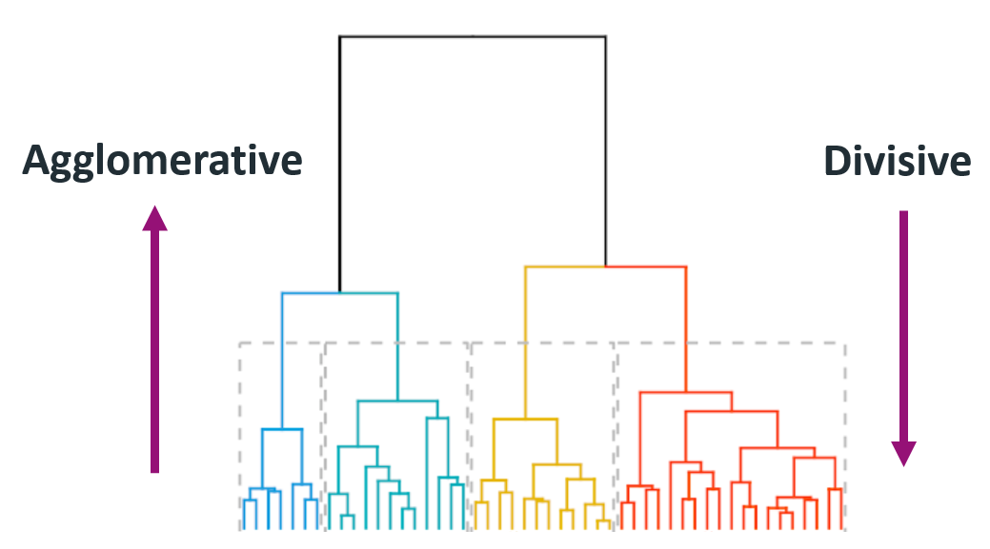
Hierarchical Clustering
Assign each observation to its own cluster. Then,
compute the similarity (e.g., distance) between each of the clusters and join the two
most similar clusters.

Slide 10
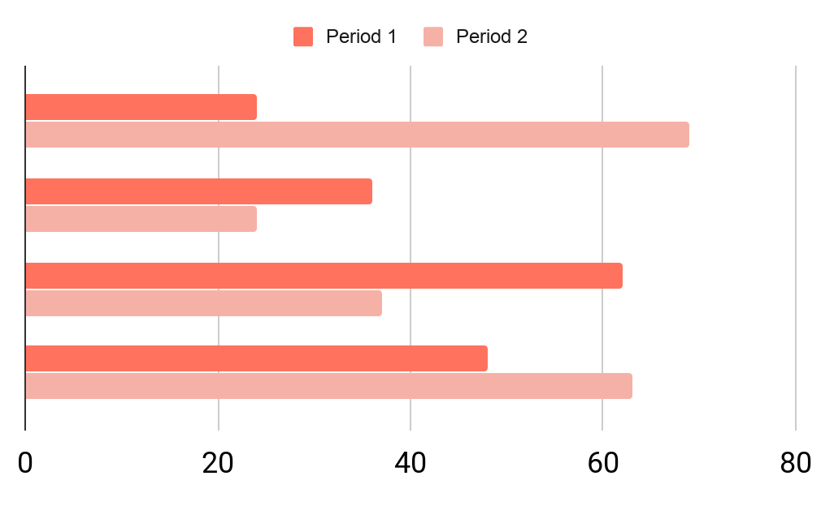
OUR BUDGETS
OBJECTIVES
35%
50%
Games
Media
To modify this graph, click on the link, change the data and paste the new graph here

Slide 11
$8,500,000
This is the total budget

Slide 12

A PICTURE IS WORTH A THOUSAND WORDS

Slide 13
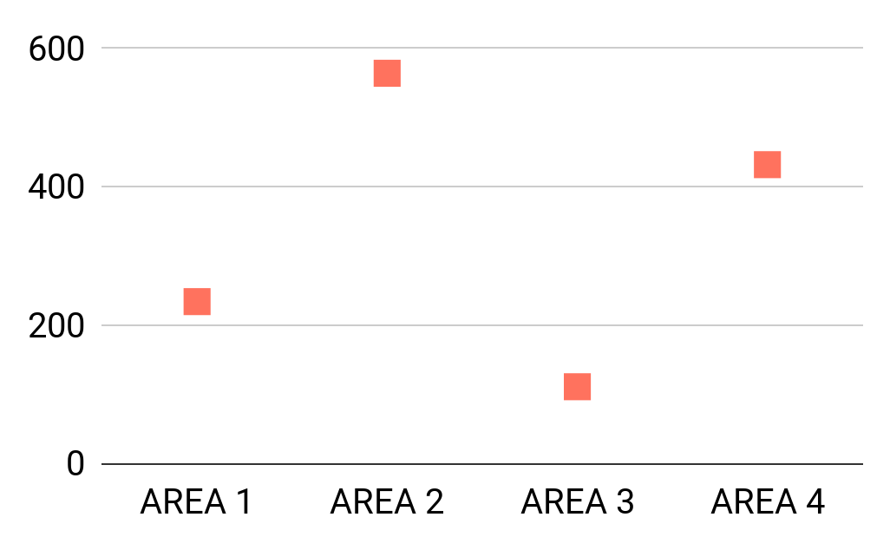
PREDICTED RESULTS
$20,000
88,000
Expected income for 2020
New employees next year
To modify this graph, click on it, follow the link, change the data and paste the new graph here

Slide 14
AROUND THE WORLD
MARS
VENUS
Map about the clients of our company:
Mars is actually a cold place
Venus has a beautiful name

Slide 15
04
SNEAK PEEK
You could enter a subtitle
here if you need it

Slide 16

SNEAK PEEK
You can replace the image on the screen with your own work. Just right-click on the image and choose “Replace image” (Google Slides) or “Change Picture” (PowerPoint)

Slide 17

SNEAK PEEK IN STREAMING

Slide 18
PROJECT STAGES
 | STAGE 1 | STAGE 2 | STAGE 3
MERCURY | Mercury is the smallest planet of them all | Ceres is in the main asteroid belt | Neptune is very far away from Earth
MARS | Venus is the second planet from the Sun | Jupiter is the biggest planet of them all | Earth is the planet where we live on
JUPITER | Pluto is an icy dwarf planet | Mars is actually a cold place | Saturn is a gas giant and has several rings

Slide 19
OUR PARTNERS
MERCURY
VENUS
MARS
JUPITER
SATURN
NEPTUNE
Mercury is the closest planet to the Sun
Venus is the second planet from the Sun
Despite being red, Mars is actually a cold place
It’s the biggest planet in the Solar System
Saturn is composed of hydrogen and helium
Neptune is the farthest planet from the Sun

Slide 20
THANK
YOU!!!!!
Do you have any questions?
youremail@freepik.com
+91 620 421 838
yourcompany.com
Please keep this slide for attribution

Slide 21
ALTERNATIVE RESOURCES
Find more illustrations like these on Stories by Freepik

Slide 22
PRESENTATION RESOURCES
Did you like the resources on this template? Get them for free on our other websites
VECTORS:
Business deal
Organizing projects
Rising
Market launch
Businessman
Mobile Marketing
Businesswoman
Connected
Startup life
PHOTOS:
Young woman working on blueprint on desk
Smiling woman talking on smartphone with holding white paper at workplace
Smiling attractive female real estate broker sitting in office
Lawyer with client
Find more illustrations like these on Stories by Freepik

Slide 23
Instructions for use
In order to use this template, you must credit Slidesgo by keeping the Thanks slide.
You are allowed to:
- Modify this template.
- Use it for both personal and commercial projects.
You are not allowed to:
- Sublicense, sell or rent any of Slidesgo Content (or a modified version of Slidesgo Content).
- Distribute Slidesgo Content unless it has been expressly authorized by Slidesgo.
- Include Slidesgo Content in an online or offline database or file.
- Offer Slidesgo templates (or modified versions of Slidesgo templates) for download.
- Acquire the copyright of Slidesgo Content.
For more information about editing slides, please read our FAQs or visit Slidesgo School:
https://slidesgo.com/faqs and https://slidesgo.com/slidesgo-school

Slide 24
Fonts & colors used
This presentation has been made using the following fonts:
Sarala Bold
(https://fonts.google.com/specimen/Sarala)
Montserrat
(https://fonts.google.com/specimen/Montserrat)
#ffffffff
#000000ff
#f6b1a7ff
#ff725eff

Slide 25
Stories by Freepik
Create your Story with our illustrated concepts. Choose the style you like the most, edit its colors, pick the background and layers you want to show and bring them to life with the animator panel! It will boost your presentation. Check out how it works.
Pana
Amico
Bro
Rafiki

Slide 26
Use our editable graphic resources...
You can easily resize these resources without losing quality. To change the color, just ungroup the resource and click on the object you want to change. Then, click on the paint bucket and select the color you want. Group the resource again when you’re done.

Slide 29
JANUARY
FEBRUARY
MARCH
APRIL
MAY
JUNE
PHASE 1
Task 1
Task 2
PHASE 2
Task 1
Task 2
JANUARY
FEBRUARY
MARCH
APRIL
PHASE 1
Task 1
Task 2

Slide 32
...and our sets of editable icons
You can resize these icons without losing quality.
You can change the stroke and fill color; just select the icon and click on the paint bucket/pen.
In Google Slides, you can also use Flaticon’s extension, allowing you to customize and add even more icons.

Slide 33
Educational Icons
Medical Icons

Slide 34
Business Icons
Teamwork Icons

Slide 35
Help & Support Icons
Avatar Icons

Slide 36
Creative Process Icons
Performing Arts Icons

Slide 37
Nature Icons

Slide 38
SEO & Marketing Icons

Slide 39


